Slide 1
Overview of OSS BSS

Slide 2
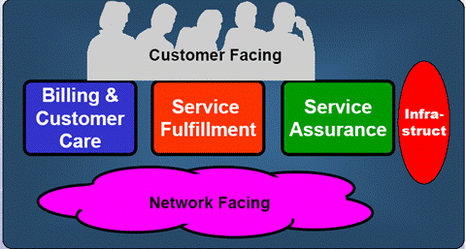
OSS/BSS Overview
Operational Support Systems (OSS) / Business Support Systems (BSS) are home-grown or ready-made IT tools (software) that are developed and used to automate a Service Provider’s Business Processes (create, deploy, manage, and maintenance of communication services, Customer requests and effective operation of the network).
OSS = Operations Support Systems
• Service Fulfillment
• Service Assurance
• Network management
BSS = Business Support Systems
• Billing automation
• Customer care automation

Slide 3







OSS/BSS Breakup
Notification
Engine
BRM
Collections Mgmt
Point of Sale
CRM
EDRMS /
Fraud Mgmt
Order
Execution
Workforce Mgmt
Interconnect
Mediation
Fault Mgmt
Provisioning
Inventory Mgmt

Slide 4
Business Support Systems

Slide 5
BSS Point of Sale (PoS)
A Point of Sale is any location from which the customer can purchase a product / service
The different common points of sales in the telecom landscape are,
Dealers
These are telecom company showrooms or retail locations where the customer can make a purchase. These could be connected through a Point of Sale web portal or they could be unconnected where the orders are processed offline
Self Service Portal
The customer could request for additional value added services or sub products from the self service portal
Directly on CRM
The customer could call the Call Center and request for additional value added services or other sub products
We will focus on the Dealers as the other two PoS will follow a sub set of this process

Slide 6
BSS Customer Relationship Management
Strategy for managing a company’s interactions with customers, clients and sales prospects
Involves using technology to organize, automate, and synchronize business processes - principally sales activities, but also those for marketing, customer service, and technical support
Main goal is to find, attract, and win new clients, nurture and retain those the company already has
Different CRM activities related to Order Management are,
Register and track all orders
Provide facility to create order by back office operators
Provide facility for Call Center operators to initiate modification orders
Validate that all required Customer Details are received
Initiate Blacklist Check for the Customer
Track SLAs and escalate in case of delays
Track Order fall outs and resolve
Store and provide access to documents in the EDRMS

Slide 7
BSS Workforce Management
Workforce or Field Service Management to optimally plan and dispatch field service technicians with the necessary equipment to a customer's location in a timely manner
A single Field Service application is shared between the Order Management and Trouble Management processes
Field Service Management involves the following sub-activities
Demand Management
Analytics / Reporting to predict the number of work orders, helping to plan the staffing and expertise needs
Workforce Scheduling
Use predefined rules to optimize the schedule for the workforce
Advanced systems use dollar value routines to allocate the best resource to a work order
May also include a tracking and reallocation mechanism in case of delays or breakdowns

Slide 8
BSS Billing & Revenue Management
Billing is the process of identifying the rate for each service used by the user and generating a consolidated bill or invoice at the end of the billing cycle
It also keeps track, of the customer’s balance (prepaid) or credit limit (postpaid) and triggers a intimation or the necessary dunning activities when required
The billing functions are classified into thee major parts
Mediation Platform
The Mediation Platform receives the CDR (Call Data Records) or UDR (Usage Data Records) or IPDR from the OSS Layer and validates / converts them to a common format for down stream processing
Rating Engine
The Rating Engine receives the CDR from the Mediation Platform and based on the service used and amount of usage arrives at the rate to be charged
The rating engine also applies any rating time discounts when required
AAA Gateway (Authentication, Approval and Accounting) – Real-time Billing
Approves the usage of a service by a customer
Also tracks his balance and terminates service in case of insufficient balance or exceeding the Credit Limit
May not always be done in a typical billing application

Slide 9
BSS Collections & Financials Management
Collections Management involves tracking and ensuring that payments are made for invoices generated for a customer
Billing will trigger a message to Financials every time an invoice is generated for a customer. Financials will trigger dunning (deactivation and recovery) activities in case of non payment by the due date
Financials management also takes care of,
Settlements to be made to other operators
Settlements to be made to vendors
Payments to be made to and collections to be obtained from Dealers or Retailers
Host operator reconciliation in case of MVNOs

Slide 10
BSS EDRMS
EDRMS stands for Electronic Documents and Records Management System. It refers to the combined technologies of document management and records management systems as an integrated system
All documents collected from the customer are scanned and stored as electronic records after they have been verified. These will be accessible by the users of the CRM / Portal applications.
Only after a document is undergone review, approval, lock-down and publication process, at which point it becomes a formal record for the organization
The documents may be updated with newer version (Forms), updated documents (address change), etc
The documents are retained, until some events occur which relate to the record and which trigger the final disposition schedule to apply to the record

Slide 11
Operations Support Systems

Slide 12
BSS / OSS Trouble Ticketing
Trouble Ticketing function helps in initiating, tracking and closing the reported
problems/troubles. It manages the life cycle of the problem resolution. Unique
Trouble Tickets are issued for each reported problem and these trouble tickets
can be either
Network driven(bottom up) - Raised by Fault Management System
Customer driven(top down) – Raised by customer through Email/Web/Call
Trouble Management systems also handle automatic escalation, such as
progression of a ticket from minor to major or major to critical, etc., and support a
variety of notification methods such as paging, emails, synthesis voice dial-out

Slide 13
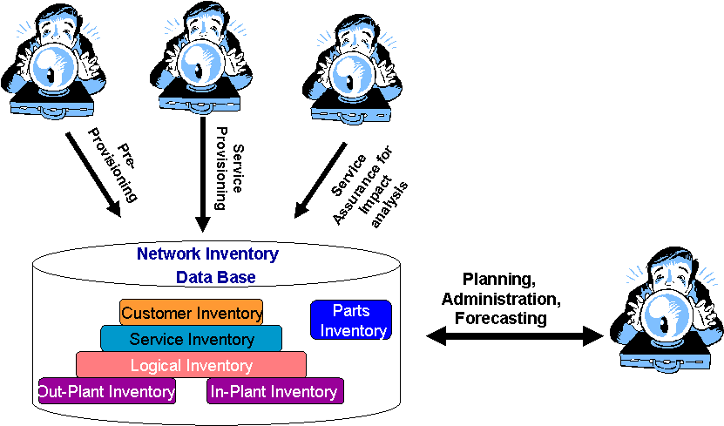
OSS / BSS Inventory Management
The inventory components are used in the execution of several other processes like
Pre - Provisioning – To find if there are enough resources/capacity in the network to provision the service to the customer
Service Provisioning – to find the free resource and get it activated for the service
Service Assurance – to find the service and customer impact of a fault
Network Reconciliation

Slide 14
OSS / BSS Inventory Management - Details
Inventory items can be:
Physical Inventory
Inside-plant physical inventory (NEs and their attributes, jacks, etc.)
Outside-plant physical inventory ( e.g. Cables and fibre)
Logical Inventory (e.g. capacity, time slots, and circuits)
Customer Inventory (e.g. Customers, contacts, and orders)
Supplier Inventory (e.g. Service providers, contacts, contracts, initial and recurrent charges, off-network resources)
Engineering and Planning Inventory (e.g. GIS information, build-out plans)
Part Inventory ( e.g. Spares, parts on order, parts in repair)

Slide 15
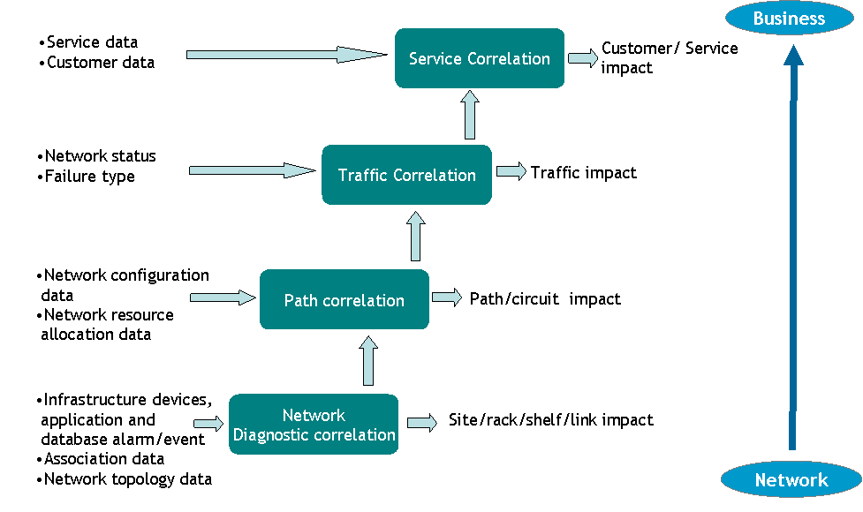
OSS Fault Management
Fault Management Systems are designed for detection, isolation and correction of
malfunctions in a communications network

Slide 16
BSS / OSS Order Management
The Order Execution Engine receives the order details from the CRM application and co-ordinates the subsequent activities
The Order Execution Engine activities are classified into two major areas,
Central Order Management (COM)
This receives and decomposes the received order into individual line items
A workflow is initiated for each of the Line Items based on their type
Interact with Inventory Management to confirm feasibility and reserve inventory
Initiate Billing on provisioning confirmation
Manage Order Fall outs and trigger escalations for Orders not activated within SLA
Trigger updates to CRM at different stages of order execution, so that the CSR is informed of the current status
Service Order Management (SOM)
Manages the service fulfillment activities for an order by interacting with activation and inventory applications
Interact and co-ordinate with Workforce Management, if any human interaction is required

Slide 17
OSS / BSS Provisioning
Provisioning means "providing" or making something available
Broadly, the steps involved in this process scenario are:
Identify the customer’s needs and create a service order
‘Provision’ the service by identifying which network devices/ elements/ resources are required for the service and reserving those resources
‘Activate’ the service by ‘turning on’ the resources identified during the previous provisioning step
Test the service and sign-off to Billing and other Business Layer Processes.

Slide 18
OSS Network Performance Management
Performance management system is used to monitor the health of the network
infrastructure. (like bandwidth usage, transfer rate, call drop details etc).
Performance Management system generally comprises of data collector, data
processing engine, database, scheduler and reporting modules.
Data collector interface with the network elements/devices directly or through the Network Management Systems (NMS)/Element Management System (EMS) and gather the usage related information
Scheduler will trigger the periodic monitoring and data collection from the network
Data processing engine receive this data from the various data collector and after processing it stores/collate the data into a single database.
Then using the reporting module one can extract this collated data and present it in desirable format.

Slide 19
OSS Interconnect
In physical terms, interconnect refers to interconnecting two networks at an agreed point where calls/traffic can be handed over.
Network-A
Point of Interconnect (PoI)
Network-B
In logical terms, interconnect is an arrangement to ensure each network in the globe is connected with another network either directly or indirectly.
Network-A
Network-X
Network-N
Network-B
Notes:
The Transferred Account Procedure is the mechanism by which operators exchange roaming billing information. This is how roaming partners are able to bill each other for the use of networks and services through a standard process.
HLR – home location Register
VLR – Visiting location Register

Slide 20
Interconnect
Process Flow
Network Information
Reference Data
Agreement Information
Network Elements
CDR Collection
CDR Formatting
Format OK?
Y
CDR Rating
Reference Data Correction
N
N
CDR Rated?
Discounting / Adjustments
CDR Collection
Analytical Reports
BI / Data warehouse
Routing Decisions
Y
Billing Period End process
Rated CDRs
Summarization
Reconciliation Reports
CDR Reconciliation
Invoice / Statement Reconciliation
GL / Financials
N
Acceptable?
Y
CDRs for Reconciliation
Statements
Payments
Invoicing
Arbitration
Settlement
Other Operators
Notes:
The Transferred Account Procedure is the mechanism by which operators exchange roaming billing information. This is how roaming partners are able to bill each other for the use of networks and services through a standard process.
Much of the traffic carried by a GSM Public Mobile Network (PMN) either originates, or terminates in another network. The operator of the local fixed network charges the wireless operator for each call that terminates at one of its fixed subscribers. And likewise, the GSM operator will charge the fixed operator for each call made to a mobile number from a fixed line.
Therefore GSM network operators and their local fixed counterparts usually negotiate an interconnect agreement to make charging as simple as possible. The other fixed international operators have normally already negotiated similar agreements amongst themselves.
Therefore, in order to place a call from a German PMN to a Canadian fixed phone, it is not necessary for the German PMN operator to negotiate a price with a Canadian fixed network operator.
The German PMN operator negotiates a price with the German fixed network operator. The German fixed network operator then negotiates a price with the Canadian fixed network operator. So, the German fixed network operator passes this call cost back to the German PMN. This means that the German PMN has to recoup the cost of the call from its subscribers either directly (retail billing), or via the appropriate Service Provider (wholesale billing).
This form of inter-administration accounting covers the division of revenue between both fixed and mobile networks. It does not, however, cover the costs incurred by foreign subscribers whilst roaming in other networks.
Consider the case of a French subscriber calling a Canadian fixed phone from within a German network.
The German fixed network will still charge the German PMN for the leg of the call placed to the Canadian number. In this case, the German PMN does not receive any revenue from its own subscriber. In order to recoup the costs incurred by the call, the German PMN must charge the home mobile network operator, here the French PMN, to cover the costs incurred by the French mobile subscriber.
The form of inter-PMN accounting for roaming traffic above is where TAP comes into its own. Roaming call records are typically created as either TAP or CIBER (Cellular Intercarrier Billing Exchange Roamer) records. CIBER records are used by mobile operators using AMPS-based technologies, such as analogue AMPS, IS-136 TDMA and IS-95 CDMA. TAP is used by GSM operators and is the main protocol in GSM dominated areas, particularly throughout the EMEA region.
CIBER (Cellular Intercarrier Billing Exchange Roamer) records.

Slide 21
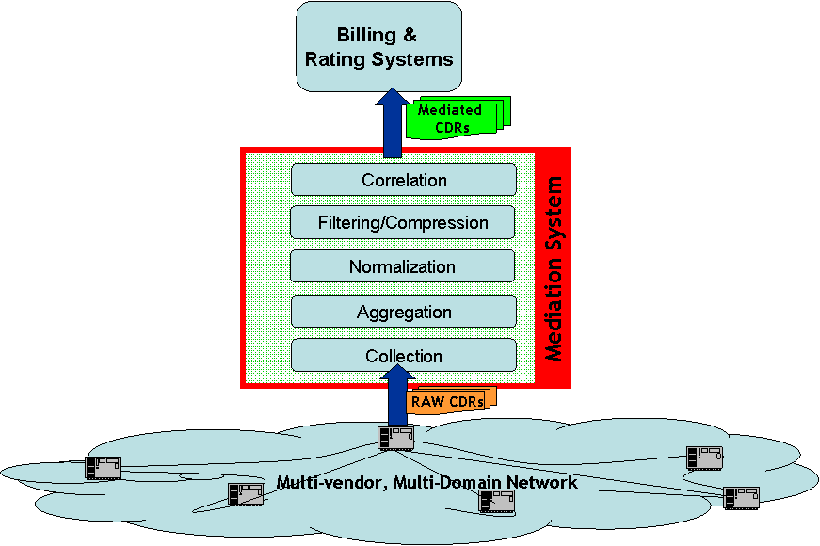
OSS Mediation
Mediation is a process through which information is exchanged between the Network elements and OSS/BSS in a Service provider's network.
Distributed to
1. Billing System
2. Interconnect System
3. Data Warehousing System
4. FMS
5. RA System

Slide 22
BSS / OSS Dunning
Define Credit Rating
Set Credit limits against different Credit Rating
Carry out a study of the credit worthiness of the Subscriber
Slot Subscribers into different Credit categories (Low Risk, High Risk)
Check Credit and overdue
Define thresholds (Credit Limit Threshold is % by $ and Dunning Threshold is $ by days overdue)
Initiate appropriate action whenever credit threshold is crossed
Initiate appropriate actions whenever payment is overdue, crossing a given number of days
Credit Actions can be
Announcement
Letter
Soft Disconnection
Hard Disconnection
External Agencies
Write off

Slide 23
BSS / OSS Fraud Management
Fraud Management systems verify billing, detect and identify unauthorized usage of service provider network assets
Drivers
To make money – professional fraudster
To save money – casual fraudster
For anonymity – criminal
For kudos – hacker
To cause loss or damage – vandal
Impact
Lost revenue
Interconnection and toll costs
Additional costs to provide enhanced capacity
Decreased customer satisfaction
Customer service costs

Slide 24

BSS / OSS Revenue Assurance
Most common metaphor is that of leaking water from a pipe,
where water stands in place of revenues or cash flows, and
the leaks represent waste
Deals with issues related to billing and collection of revenue
Use of data quality and process improvement methods that improve profits, revenues and cash flows without influencing demand
Means to identify and remedy and prevent the problems that result in financial under performance
Recovery of "lost" revenues or costs
Revenue Assurance is not directly involved in the Order Management Process. However an appropriate tracking, reporting and escalation procedure needs to be put in place to safe guard from revenue leakage due to delayed order provisioning or delay in initiating billing on provisioning completion.

Slide 25
Current BSS Products Examples
Domain | Vendor | Product Name | Functionality
CRM | Amdocs | ClarifyCRM | Customer relationship management
 | Oracle | Siebel CRM | Customer relationship management
 | Microsoft | Microsoft CRM | Customer relationship management
Billing | Intec | Singl.eView | Rating & Billing
 |  | IntermediatE | Billing Mediation
 |  | InterconnecT | Interconnect Settlement
 | Convergys | Geneva / Infinys Rating & Billing | Rating & Billing
 | Amdocs | Enabler, Ensemble | Rating & Billing
 | Comverse | Kenan | Rating & Billing
 | LHS / Schlumberger Sema | Business support and control systems (BSCS) | Rating & Billing
 | Oracle | Portal Infranet / Oracle Billing & Revenue Management (OBRM) | Rating & Billing
EAI | Tibco | BusinessWorks, Rendezvous | Enterprise Application Interface
 | IBM | Websphere, MQ Series | Enterprise Application Interface

Slide 26
Current OSS Products Examples
Domain | Vendor | Product Name | Functionality
OSS | Oracle | Order and Service Management | Order Management
 |  | Unified Inventory System | N/W Inventory Management
 |  | ASAP (Automated Service Activation Program) | Provisioning & Activation
 | Clarity | Service Manager | Provisioning & Activation
 | AdventNet | Configuration Management Server | Configuration Management
 | HP | HP TeMIP | Fault Management
 | IBM | IBM Tivoli Netcool | Fault Management
 |  | Tivoli Network Performance Management System | Performance Management system
 | Infovista | Vista Insight | Performance Management system
 | BMC | Remedy | Trouble Ticketing System
 | HP | HP Service Desk | Trouble Ticketing System

